Slide 1
Daily Tasks(OJT)
Day-1
The task on the Day-1 is to create a website using HTML, CSS. On this day I created a webpage which contains different concepts in HTML and CSS. The main thing in the webpage is navigation bar which contains different elements like Logo, Home, About, Login, Contact and Services. There is also an attractive background image with
Some content about website. I created a basic webpage without any links to the navigation bar like About, Services etc.

Slide 2
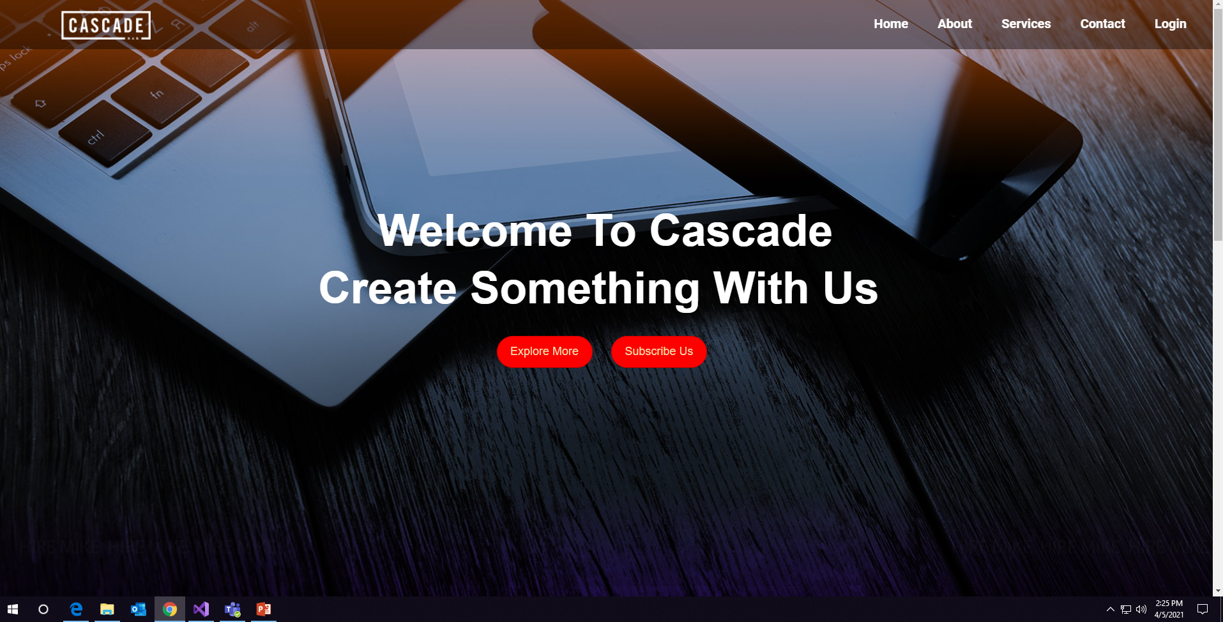

Slide 3
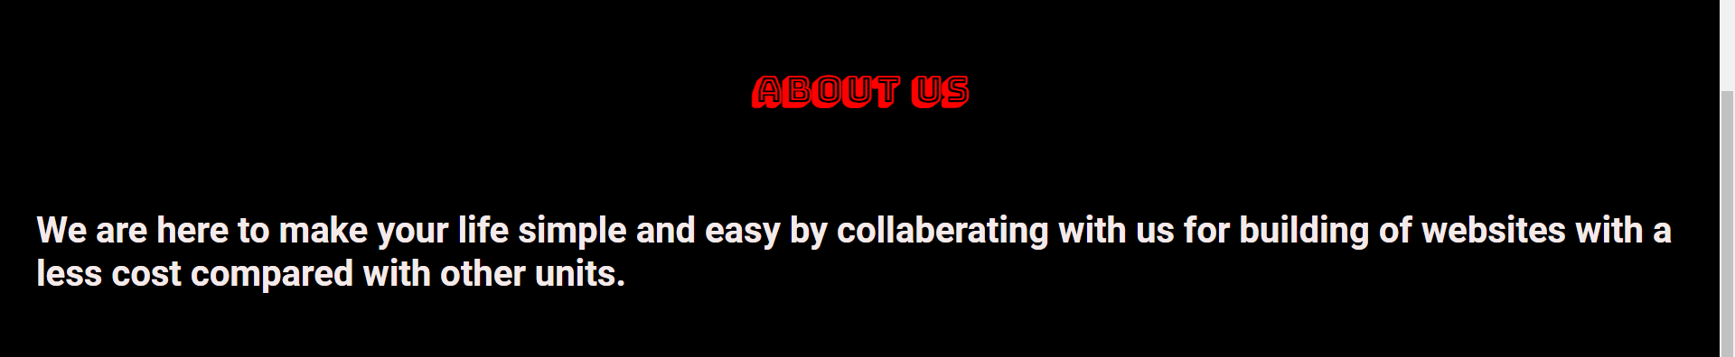
Day-2
The Day-2 Task is to create the incomplete pages like adding links to the navigation bar elements like About, Services, Contact us and Login etc. and also validation of login form.
I created some links such that if someone clicks on that link it redirects to that part of the webpage like if user click on contact link it redirects to the contact us part in the webpage.
The above starting with “We” is created in a different one. I created a typing style for that sentence.

Slide 4
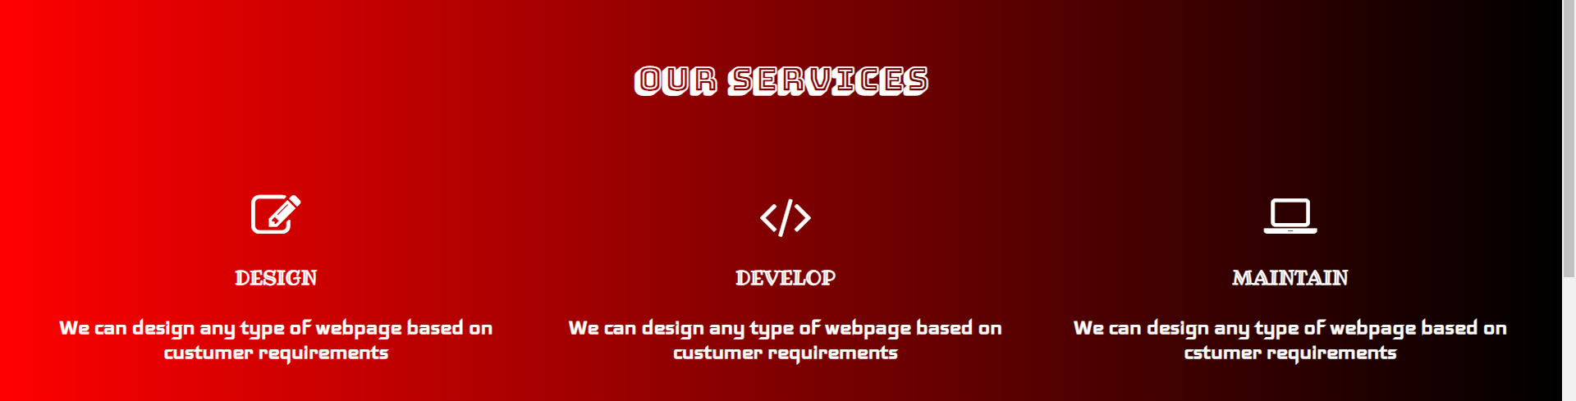


Slide 5
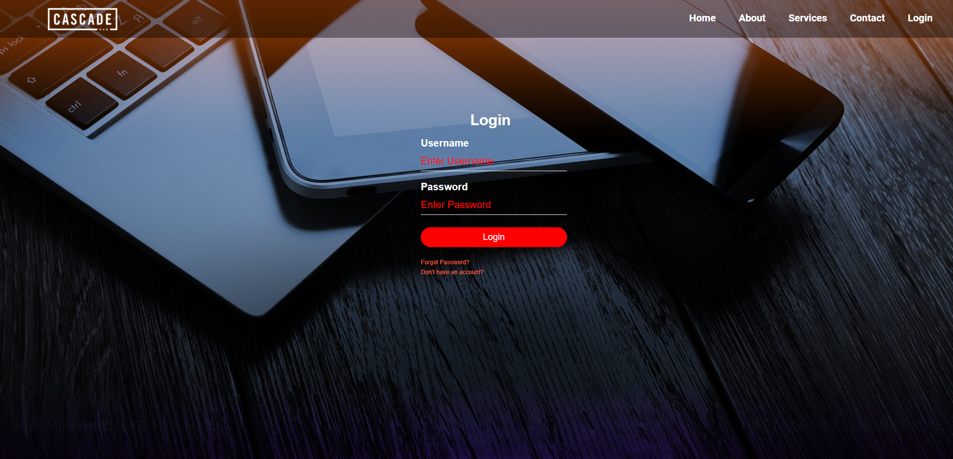

Slide 6
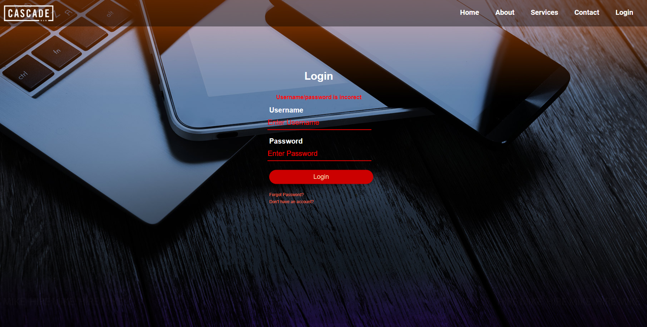
The below picture shows an error like Username/password is incorrect when the user do not fill any textbox and clicking button. The both textboxes will shake, it represents that it should not be empty.

Slide 7
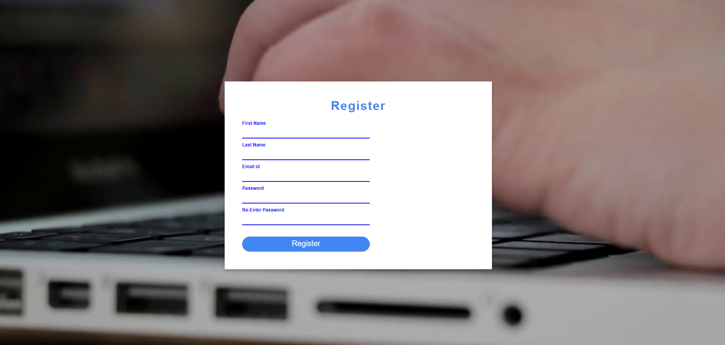
Day-3
The task in Day-3 is to create a Registration page and validate it using JavaScript and JQuery. I created different messages when user does not fill appropriate textbox field and also give alert dialog when the details are filled correct or not.

Slide 8
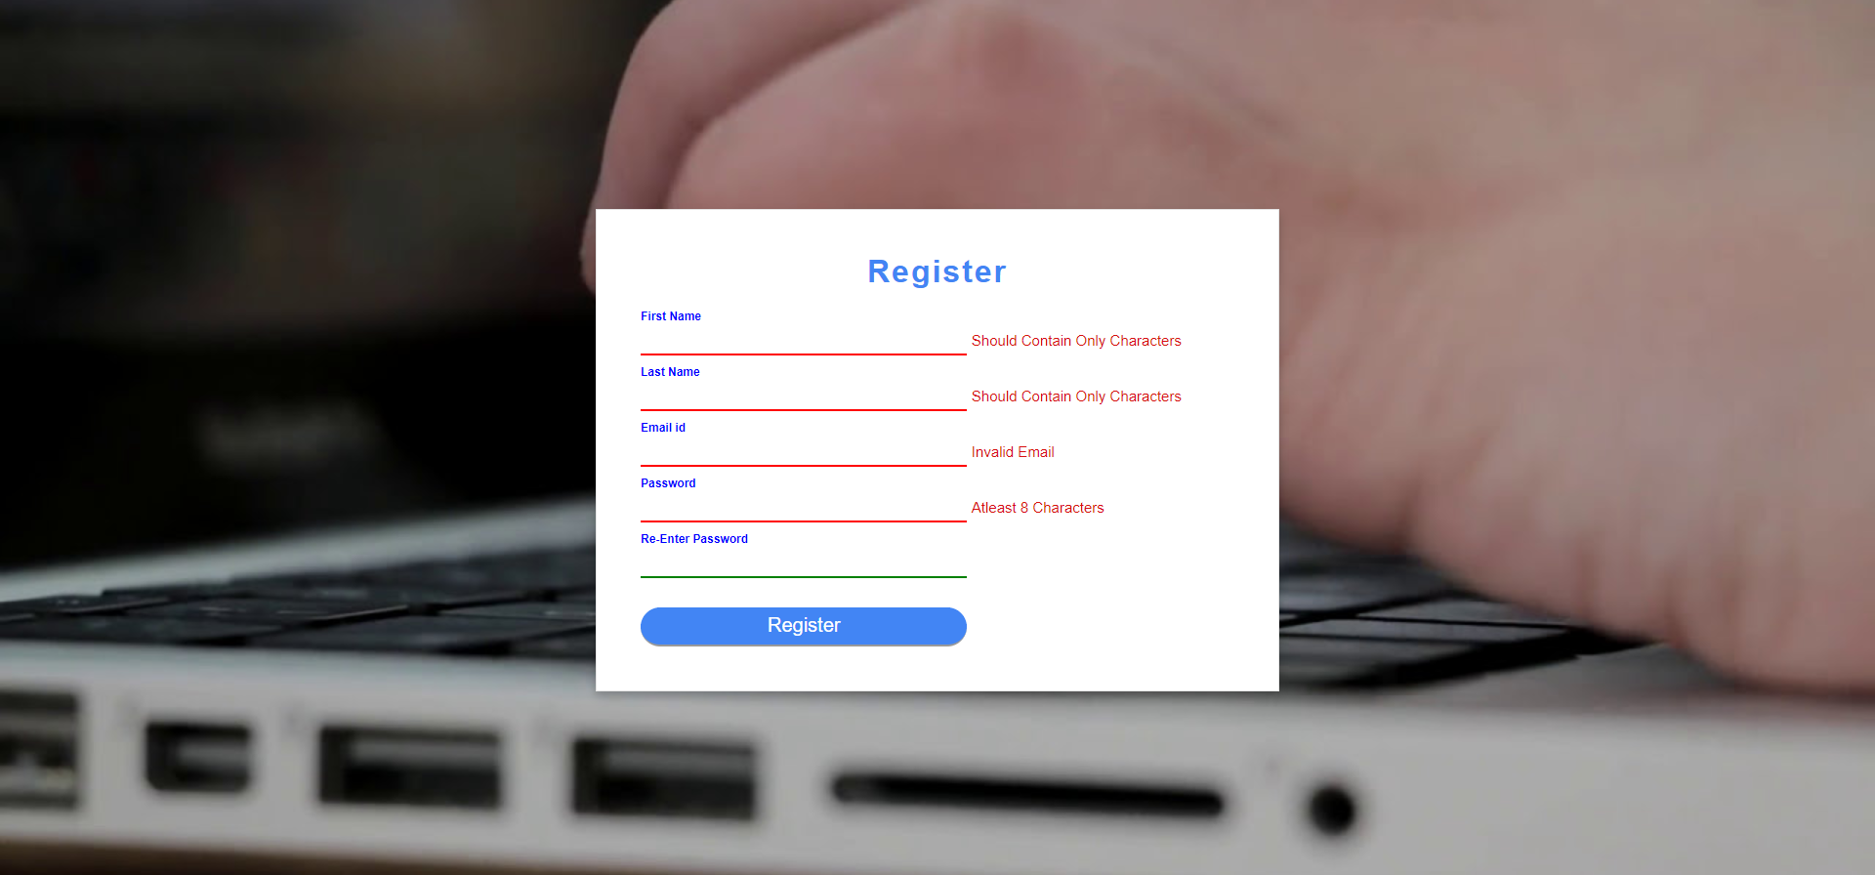
The below picture represents some messages which are appeared when the user does not provide appropriate valid information.

Slide 9
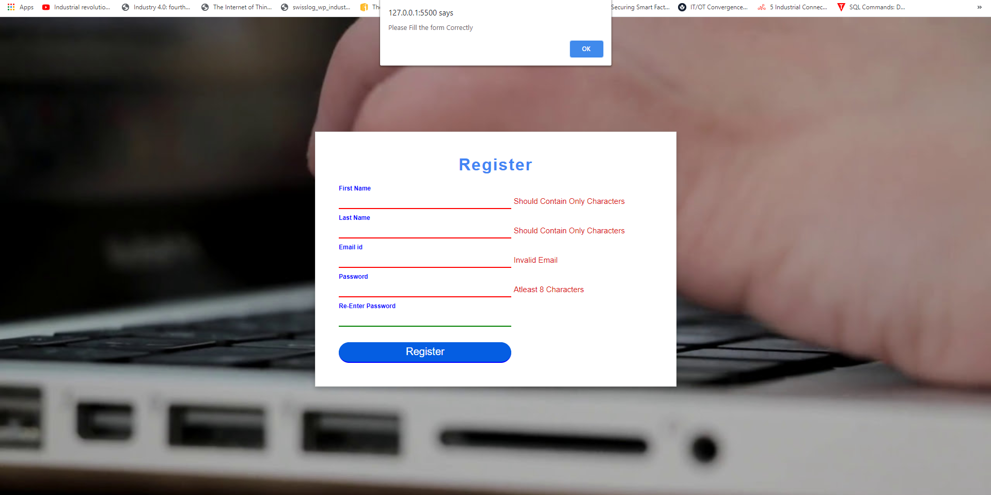
When the user clicks the button without filling the appropriate information then an alert dialog appears to fill the data correctly.

Slide 10
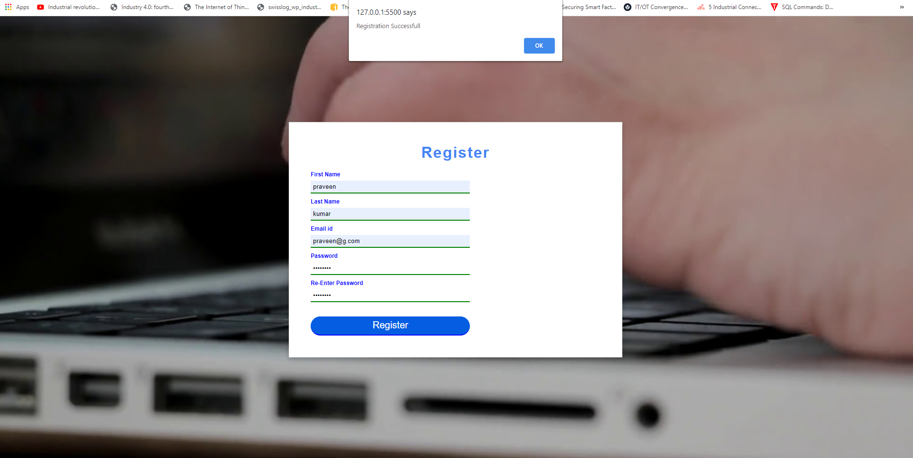
When user fill the data appropriately and click on submit then an alert dialog appears i.e.., it shows registration is successful.

Slide 11
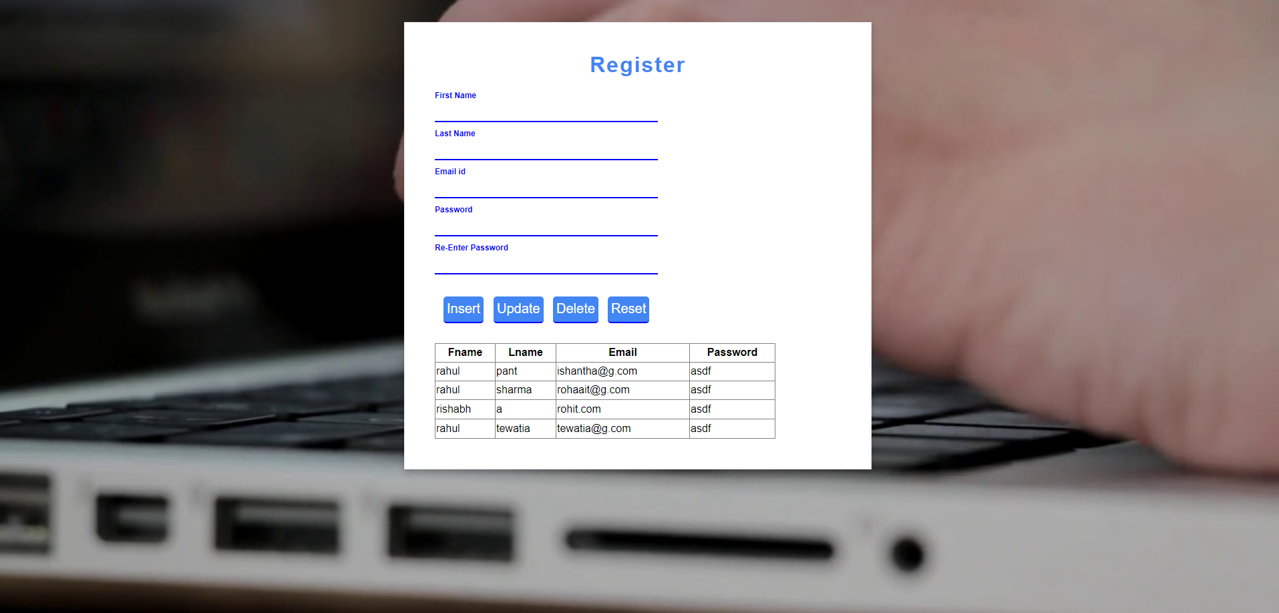
Day-4
The task in the Day-4 is to perform CRUD operations on the Registration page using ASP.net and the entered data is stored in a database(SQL Server).

Slide 12
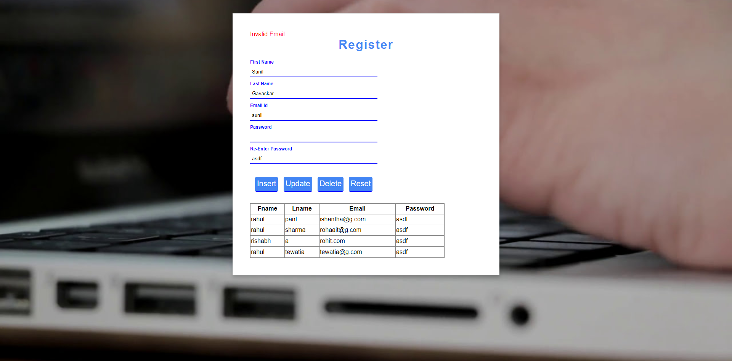
If user enter invalid email i.e., not in email format, then a message is shown as invalid email.

Slide 13
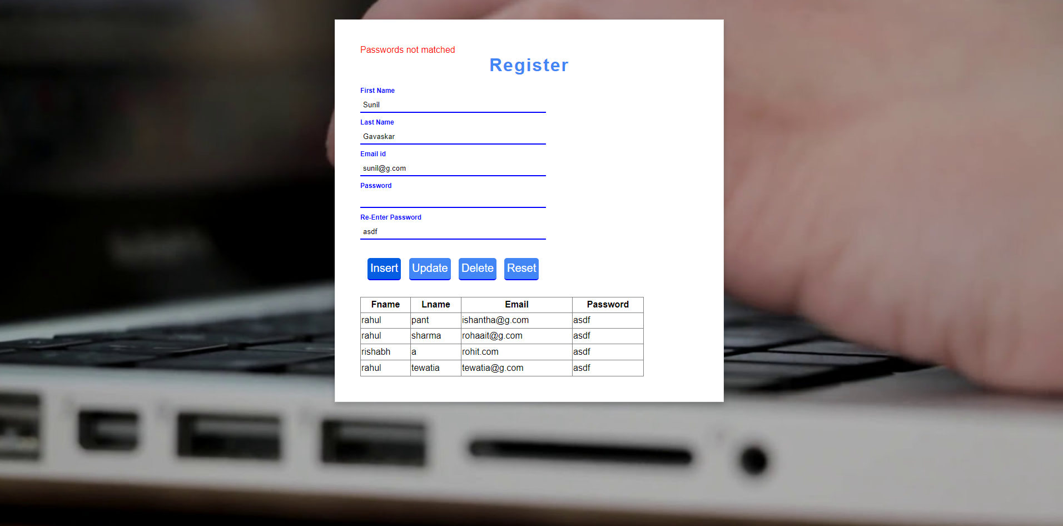
If the user enters different password in re-type password textbox then a message appears and it is shown as passwords are not matched.

Slide 14
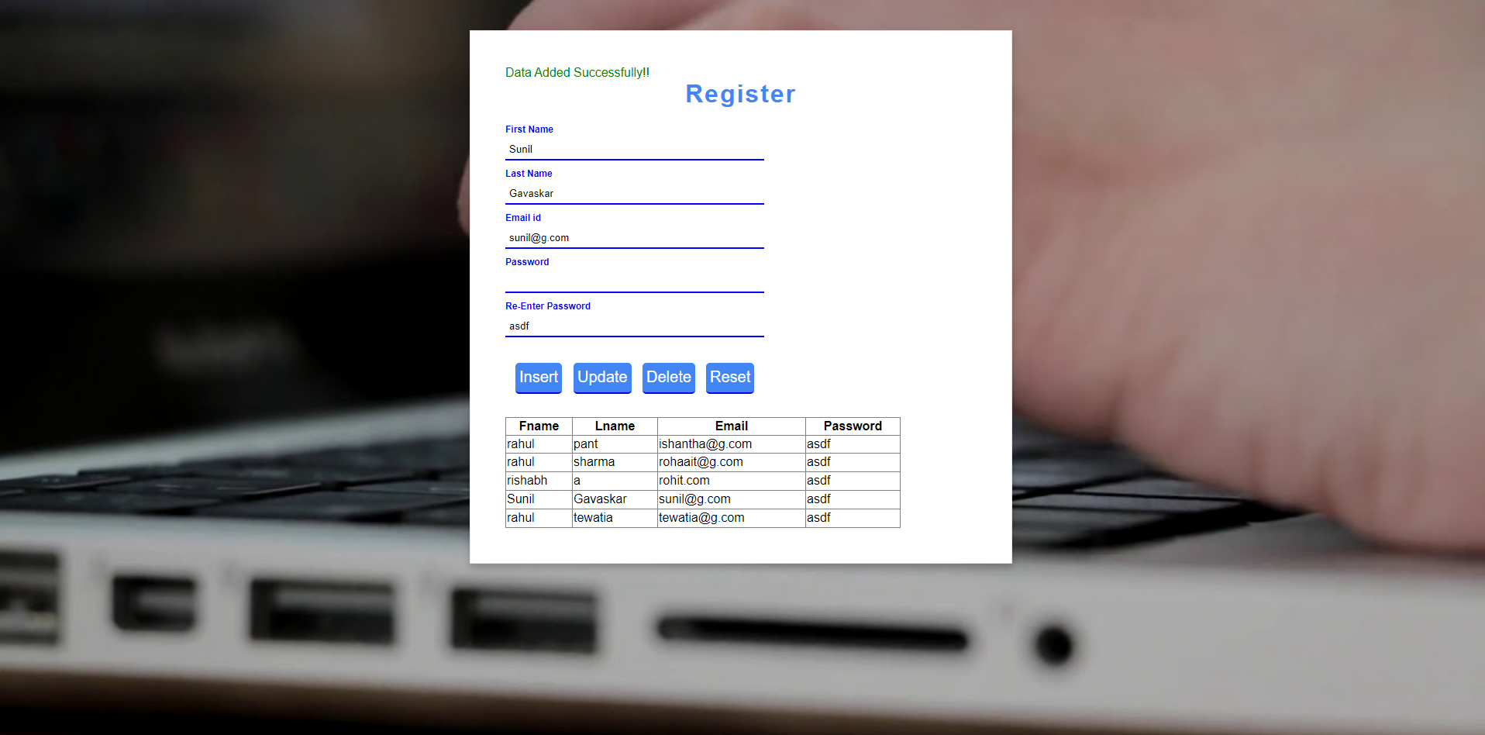
If user enters valid data then after clicking the insert button then a message is shown as data is inserted in the database.

Slide 15
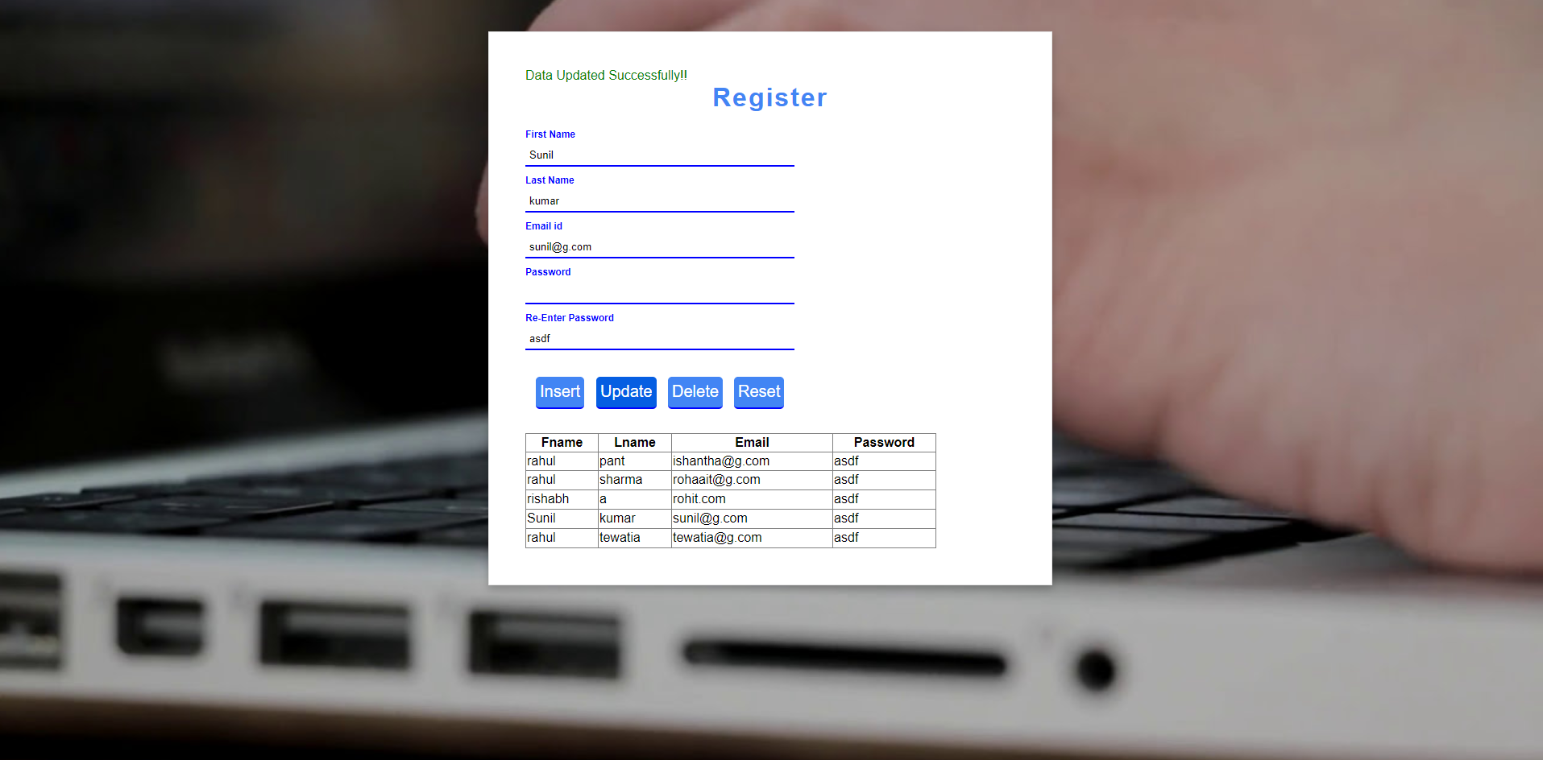
The below picture shows that the data is updated in the database based on email id(primary key).

Slide 16

The delete operation is performed based upon email address(primary key). If the user does not enter correct email address as in the database it shows a message like enter correct email.

Slide 17
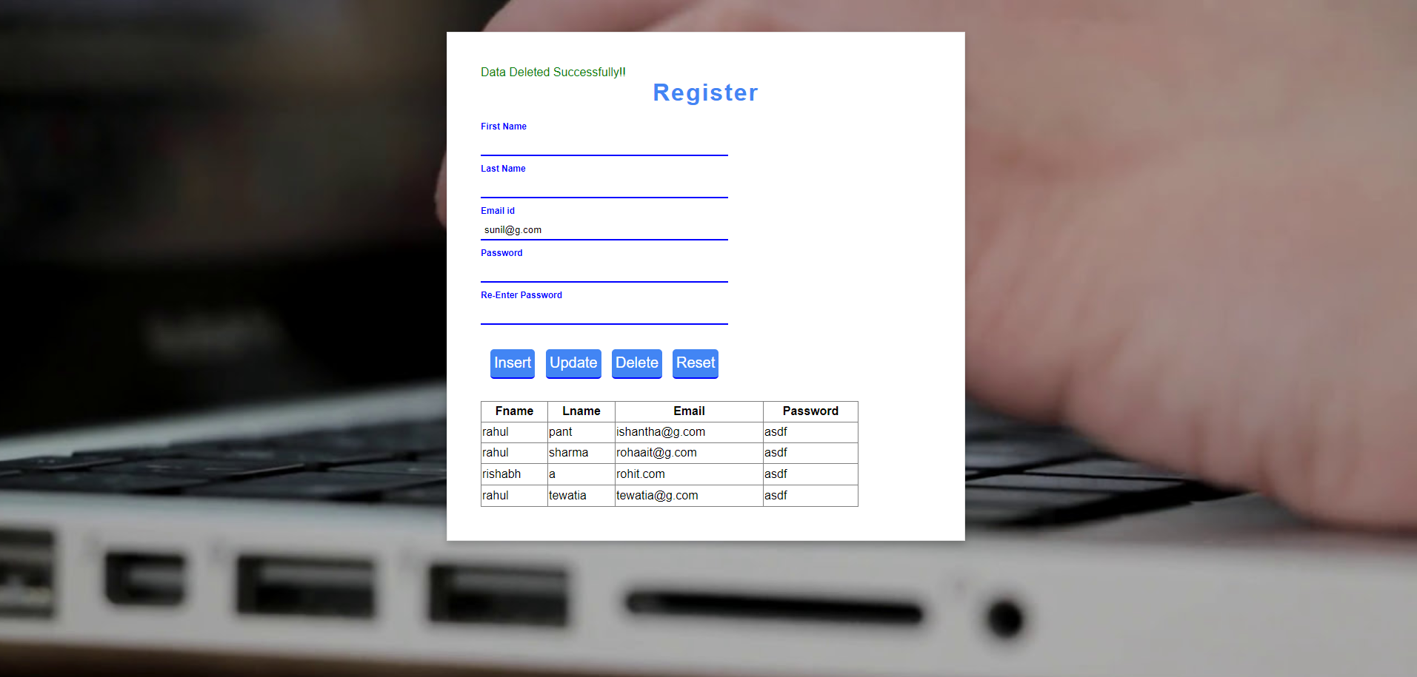
If user enters a valid email address as in the database then the respective record is deleted.

Slide 18
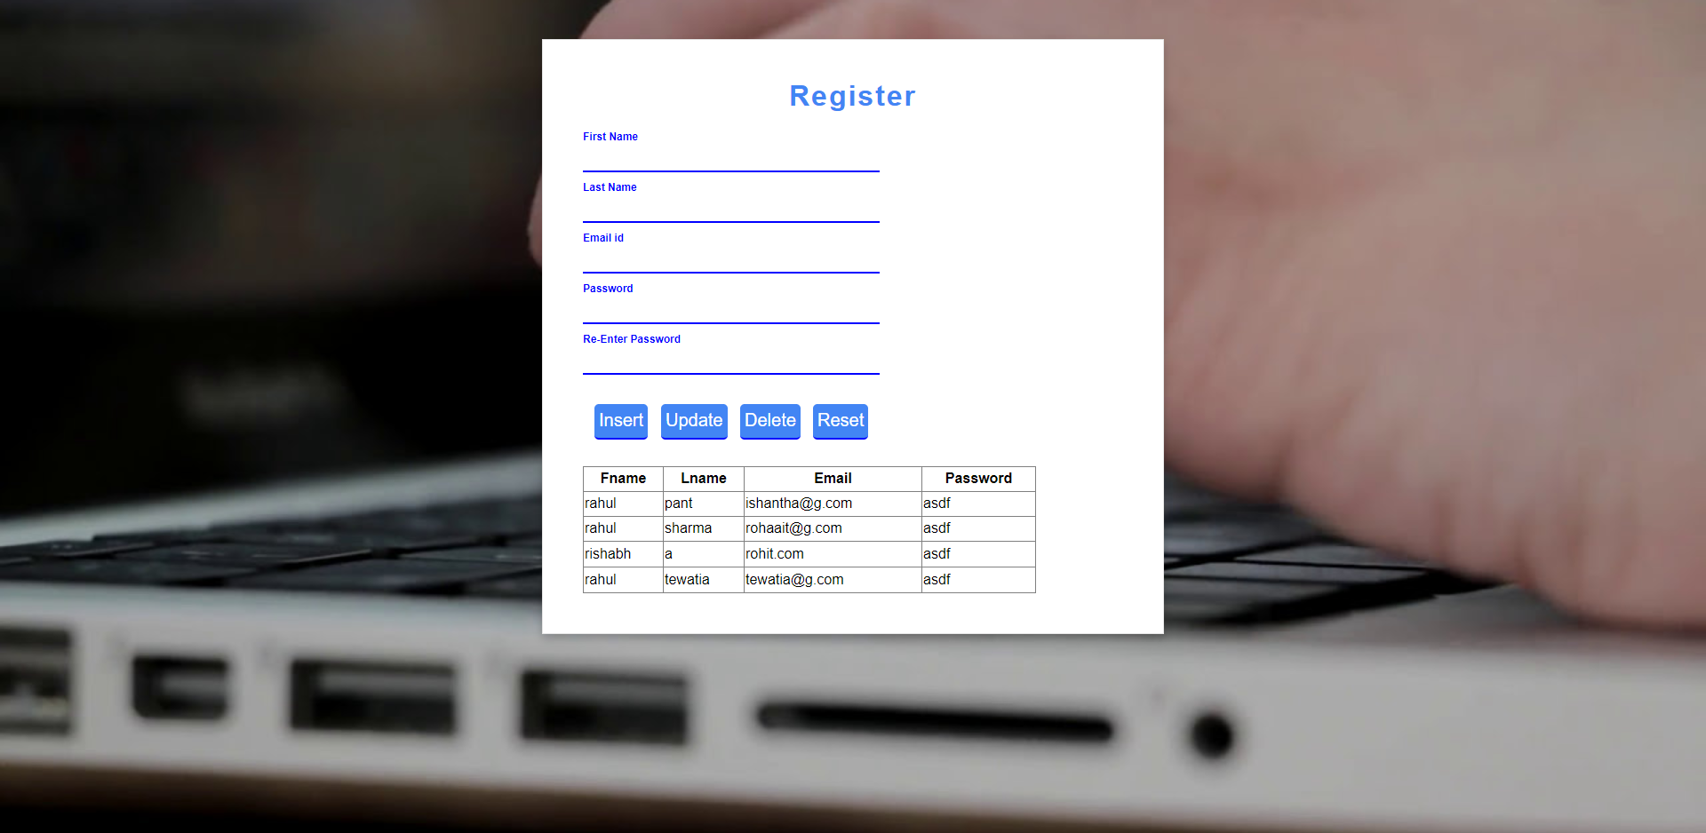
There is also a reset button which clears all the data in the textboxes.

Slide 19
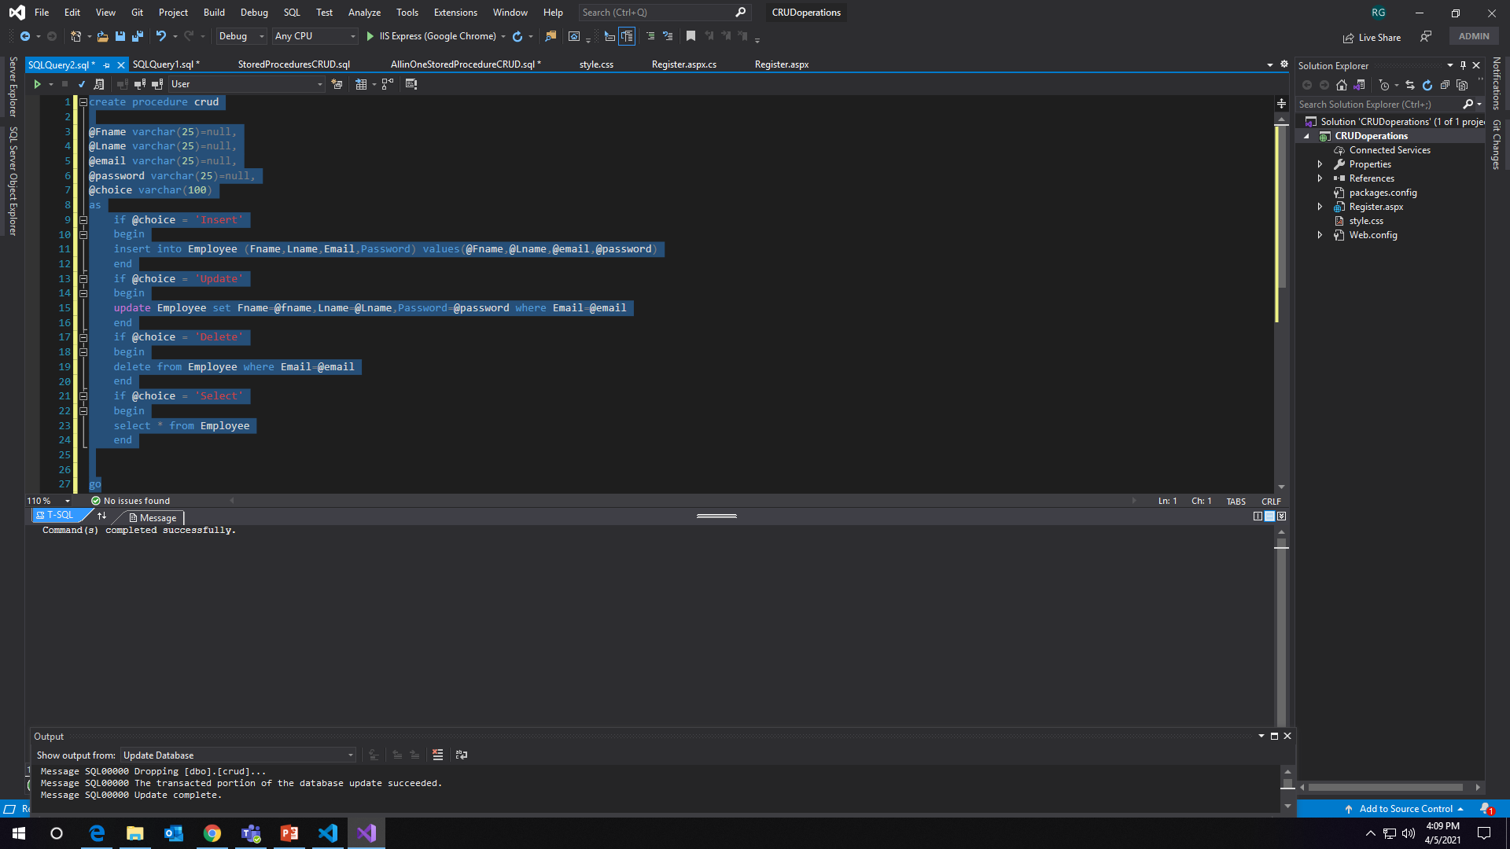
Day-5
The task in the Day-5 is to perform CRUD operations using Stored Procedures.
The below code is used to create stored procedure in SQL Server.

Slide 20
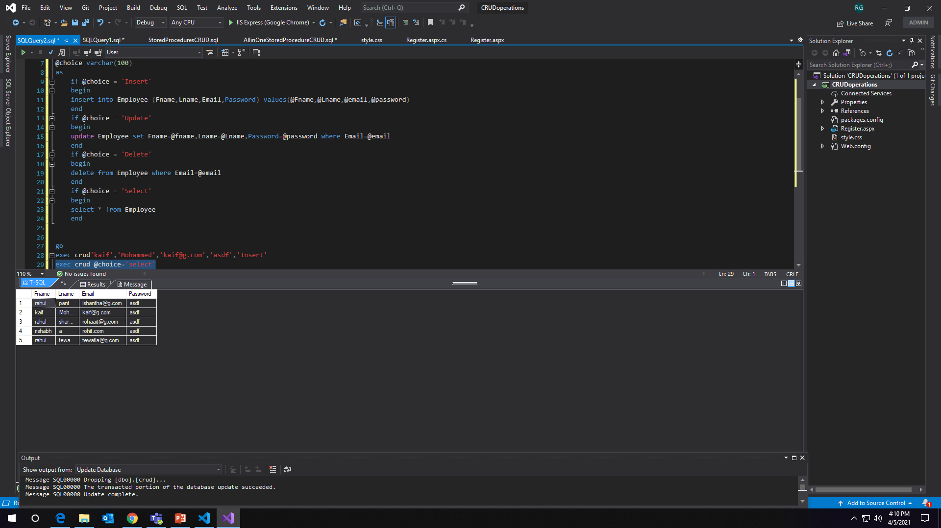
Insert:

Slide 21
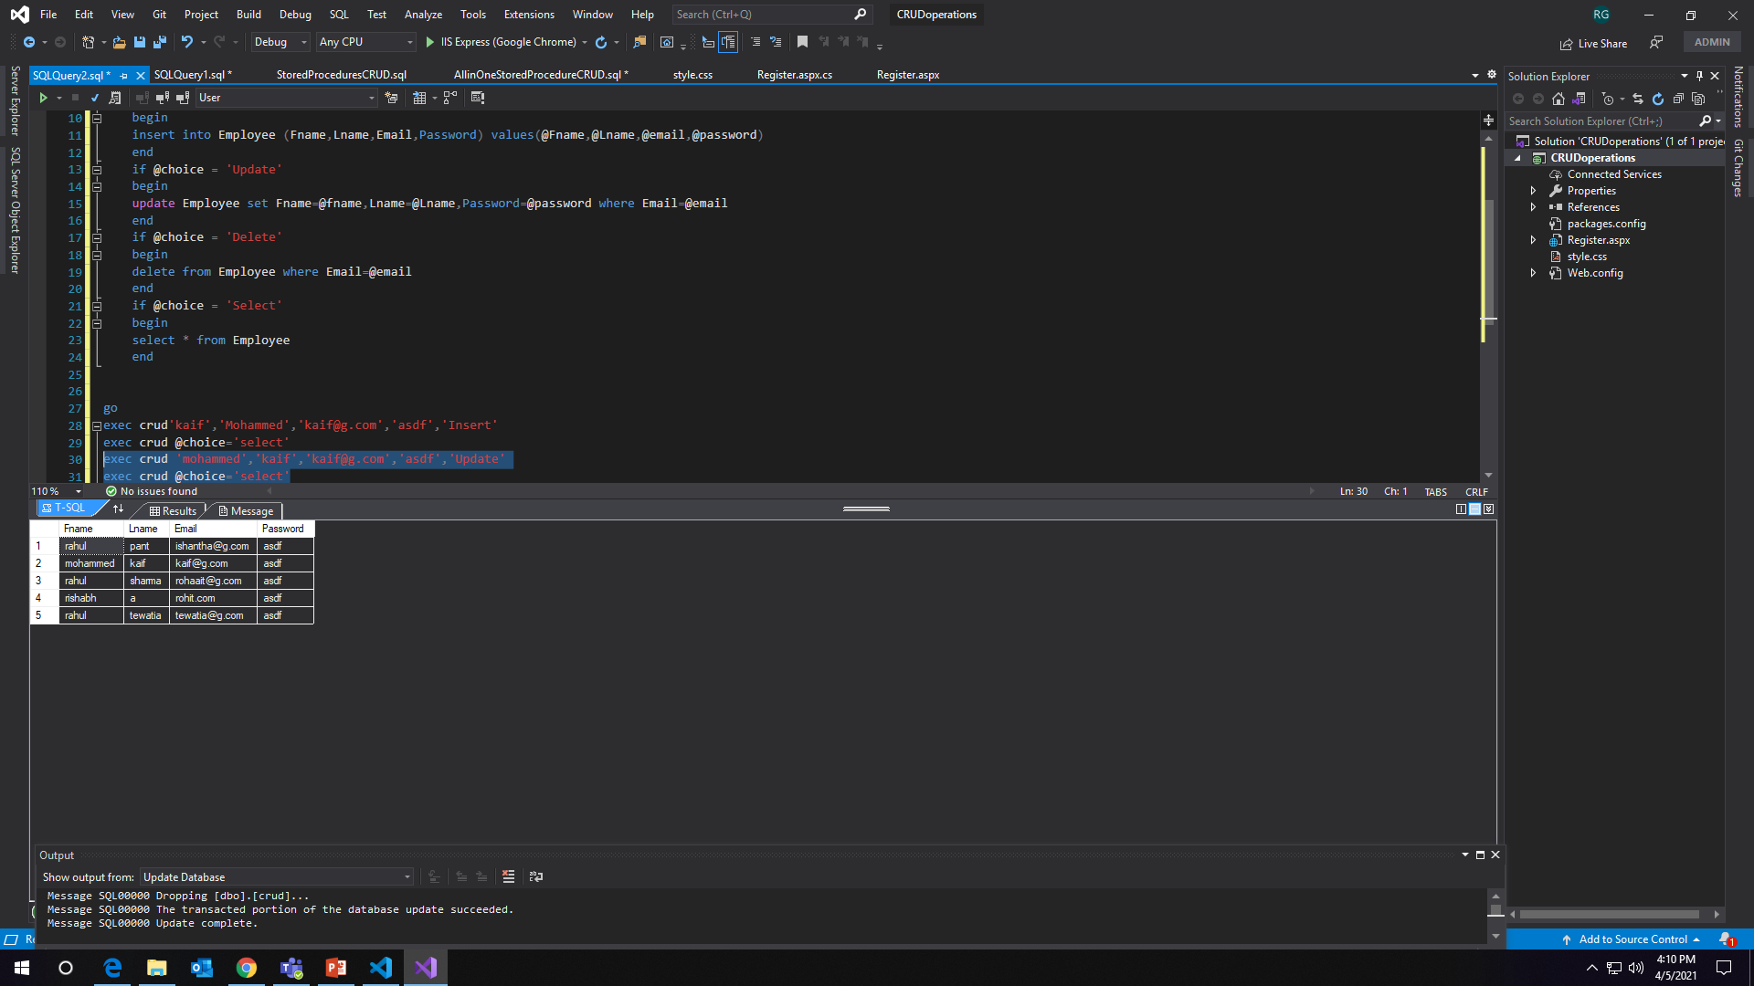
Update:

Slide 22
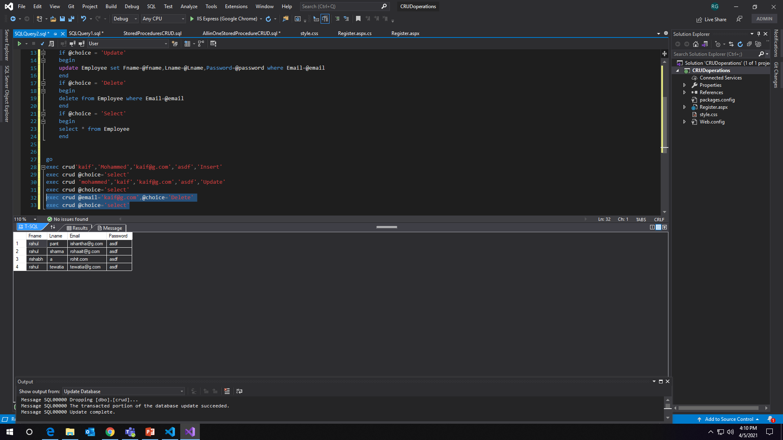
Delete:

